Slide 1
Experiment setup: common image input, two regression routes
Five methods compared on the same image:
Cross-Attention and ResNet predict E directly (without reconstructing tracks at all)
RANSAC, Hough, and Hierarchical Clustering reconstruct the track first, then convert range to energy via SRIM.
Objective: To compare the performance of CNNs with that of traditional algorithms(RANSAC, Hough, and Hierarchical Clustering)
180,000 test events
1-4 alpha tracks per event
truth E ~ U[0.3, 4.0] MeV
E1 = ? MeV
GAP + flatten (B, 512)
Mod. ResNet-18: conv1=3x3 s1, no maxpool; layer4 -> (B,512,10,6)
Linear (512 -> 128)
classifier_hidden_dim from config
E2 = ? MeV
ReLU
alpha source
Dropout (p = 0.05)
training mode only
E3 = ? MeV
Linear (128 -> 4)
num_classes = 4 per-track energy slots
out_0
0.23 MeV
out_1
0.25 MeV
out_2
-1.39 MeV
out_3
1.38 MeV
Energy regression
1 / 7
Notes:
I will briefly introduce the context and the configuration of the new experiment, Previously, we conducted classification and regression studies using an isotropic alpha source, in which the number of tracks ranges from 1 to 4. After successfully determine the track multiplicity and angles for each event, the next step is to perform energy regression to figure out the ability boundary of each approach further. To this end, we will compare 5 approaches: three traditional algorithms, namely Hough, RANSAC, and Hierarchical Cluster, and two ML approaches, namely Standard ResNet and Cross-Attention ResNet.

Slide 2
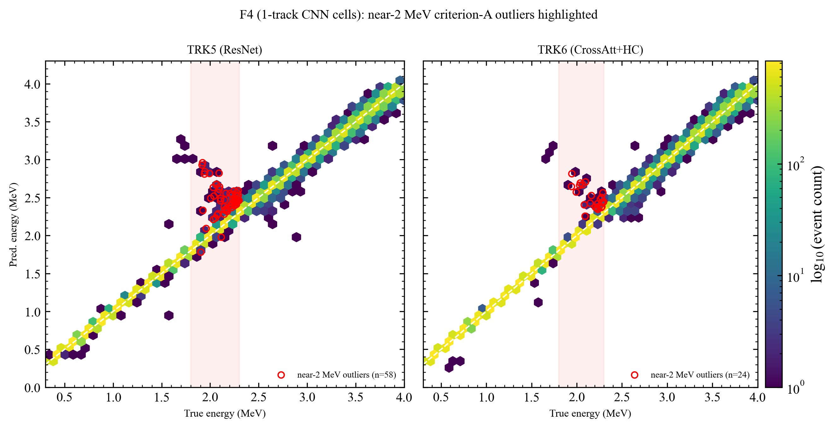
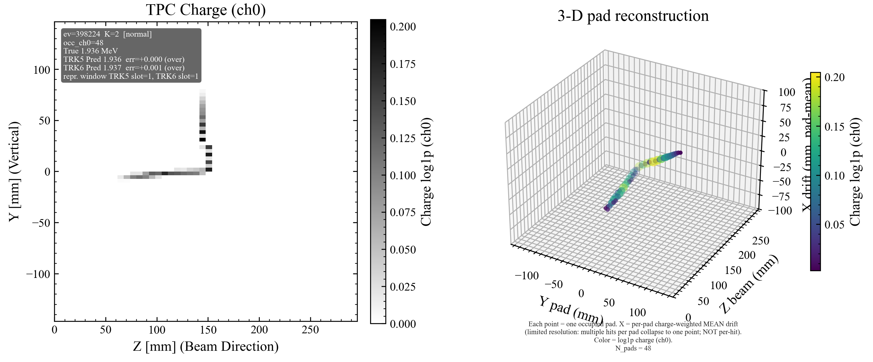
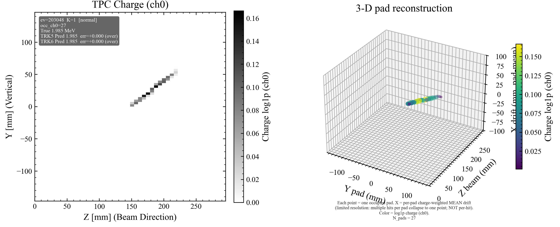
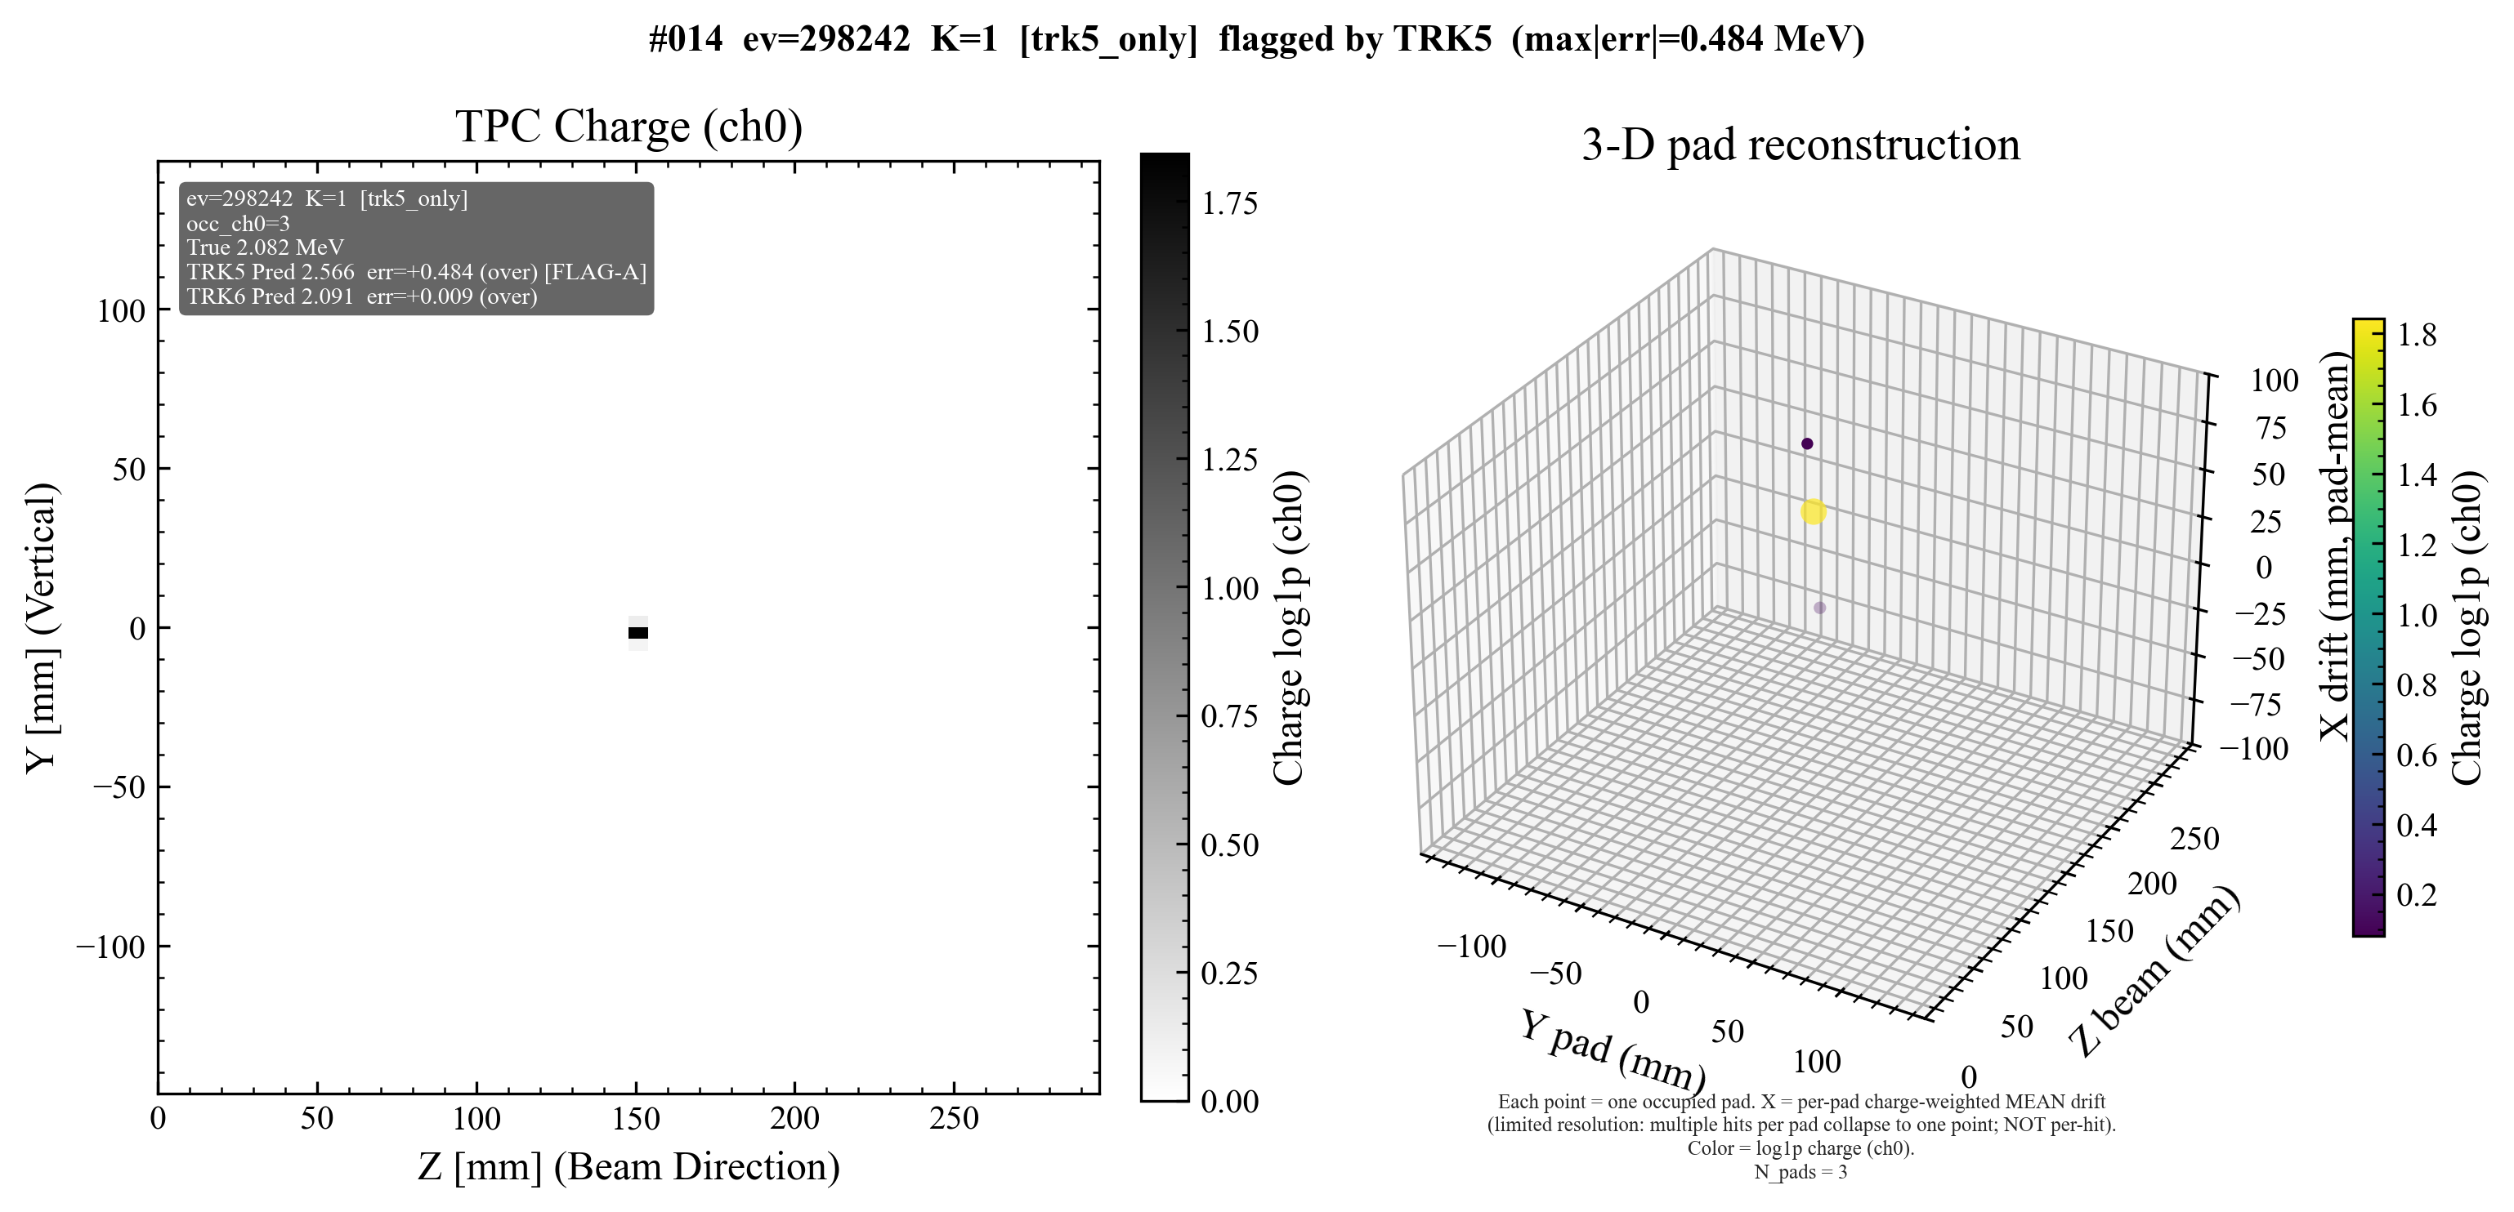
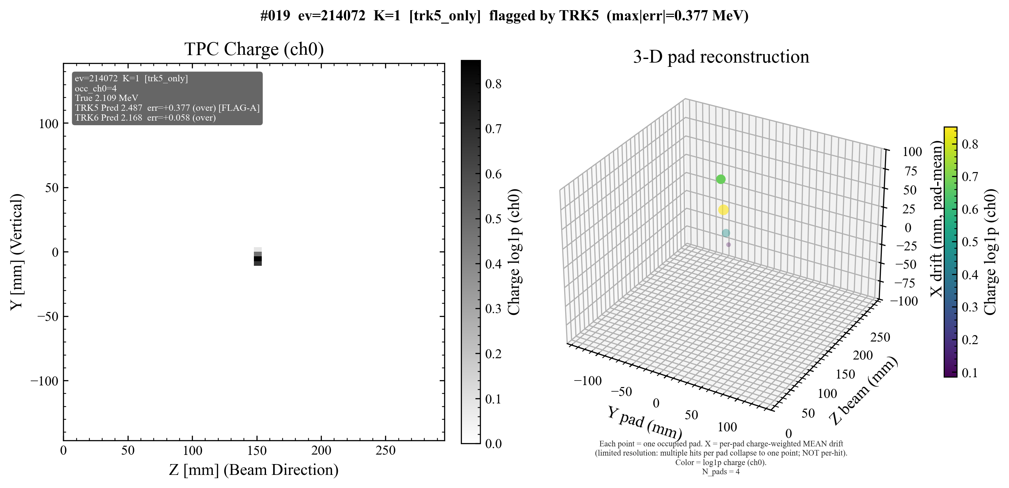
Problem 1: The abnormal events adjacent to 2 MeV
Normal
Normal
Abnormal
Abnormal
Compare CNNs on raw data
and on 80 times 48 image
Try an improvement
Energy regression
2 / 7
Notes:
Use this as the visual preview before the metric table: the CNN panels stay close to the diagonal, while the range-based baselines show broader scatter and saturation-like structure. Then move to the next slide for the quantitative RMSE, MAE, and missing-track summary.

Slide 3
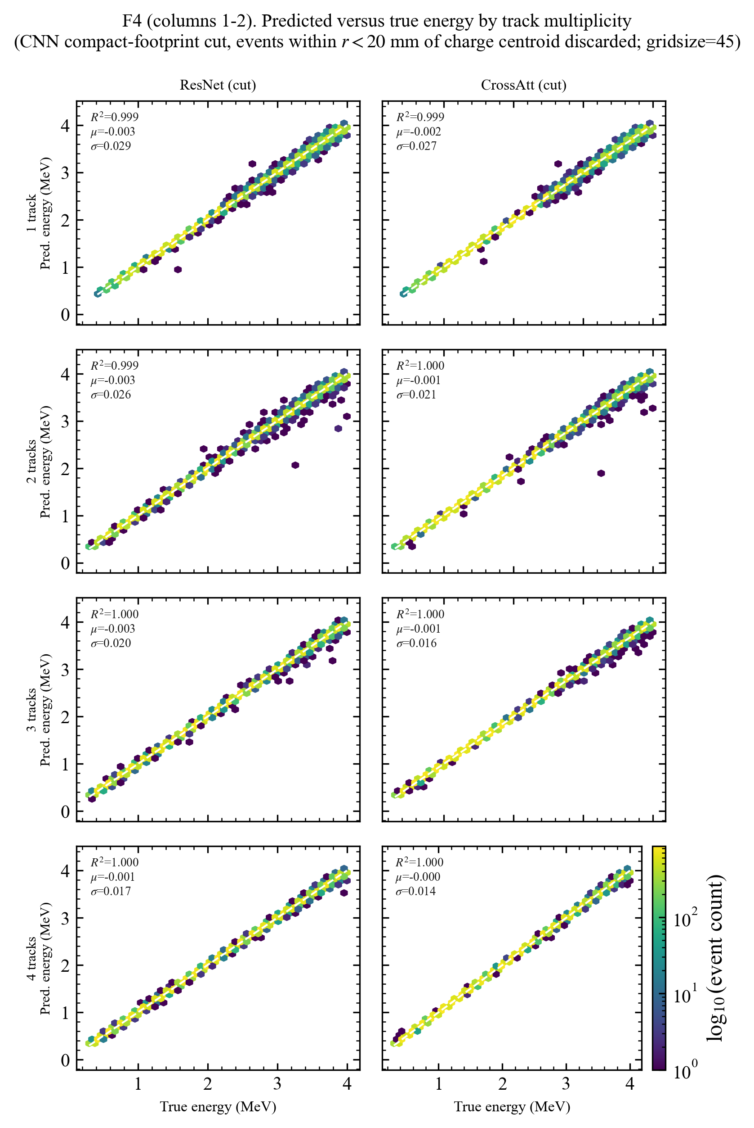
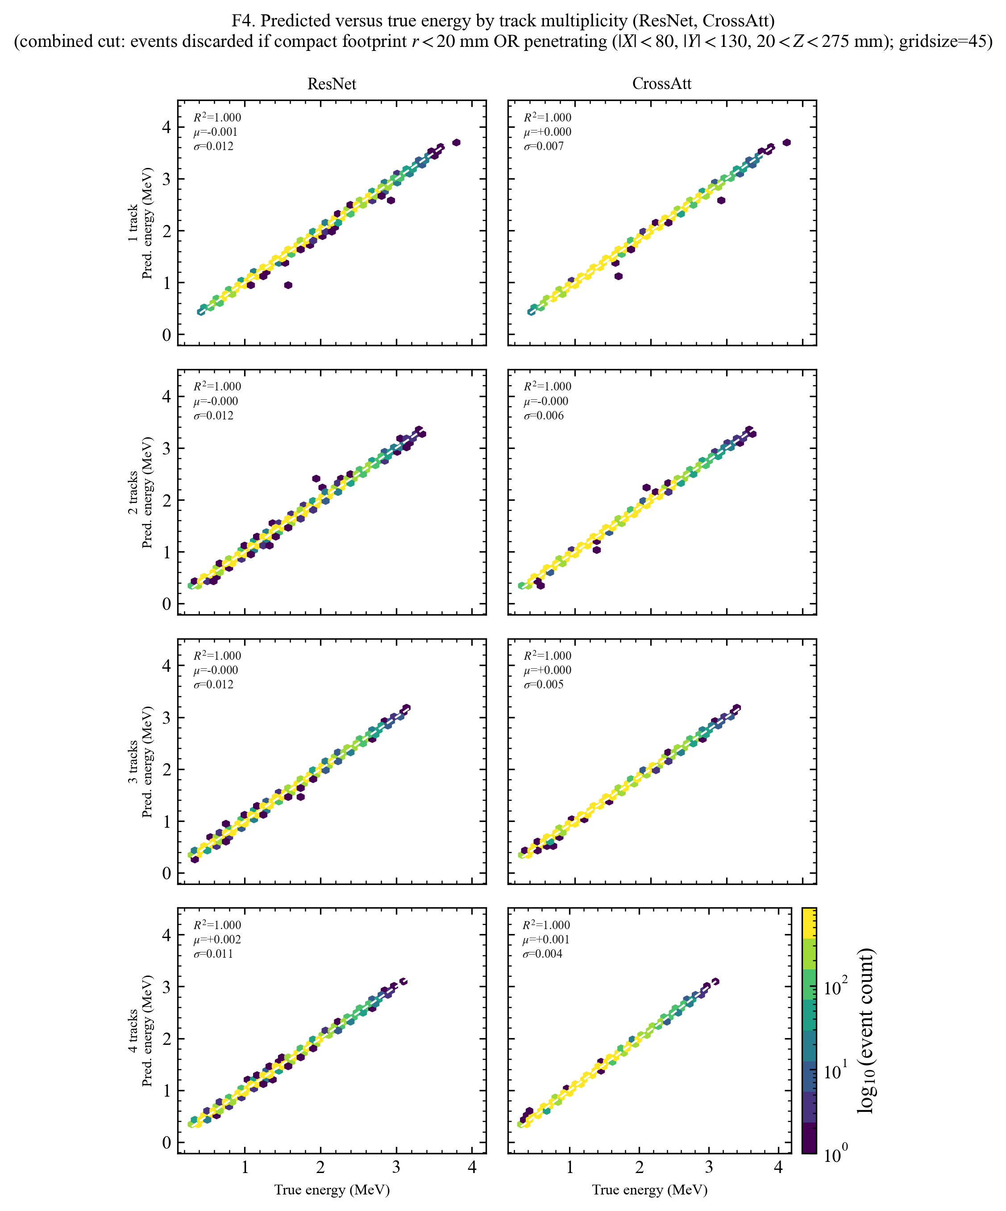
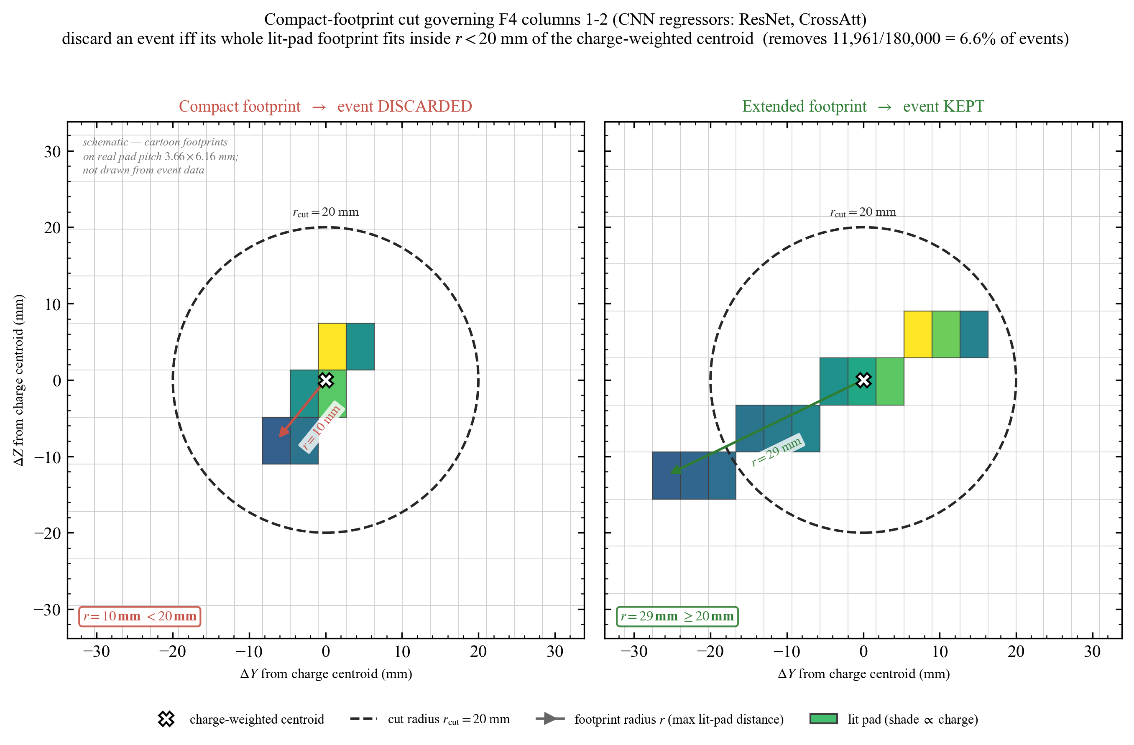
Central Cut condition
Energy regression
3 / 7
Notes:
This checks whether the gain is only an average effect. The energy-binned plot shows CrossAttention remaining competitive across bins, with the advantage most visible in the low-energy region. The physics caveat is that high-energy tracks are harder because clipping becomes more frequent.

Slide 4
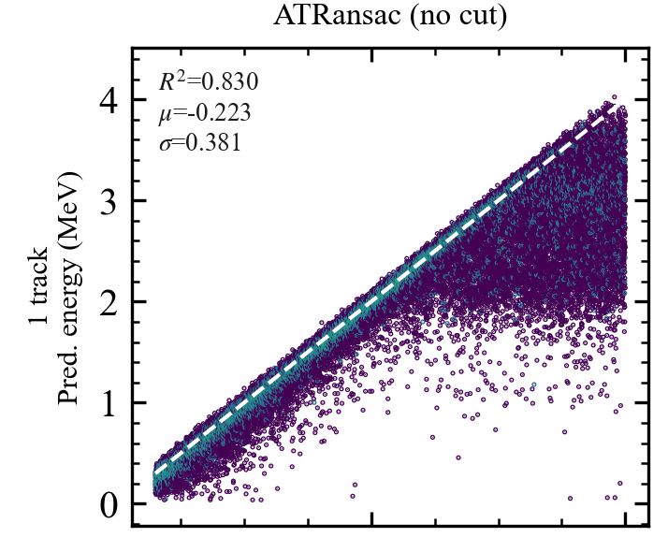
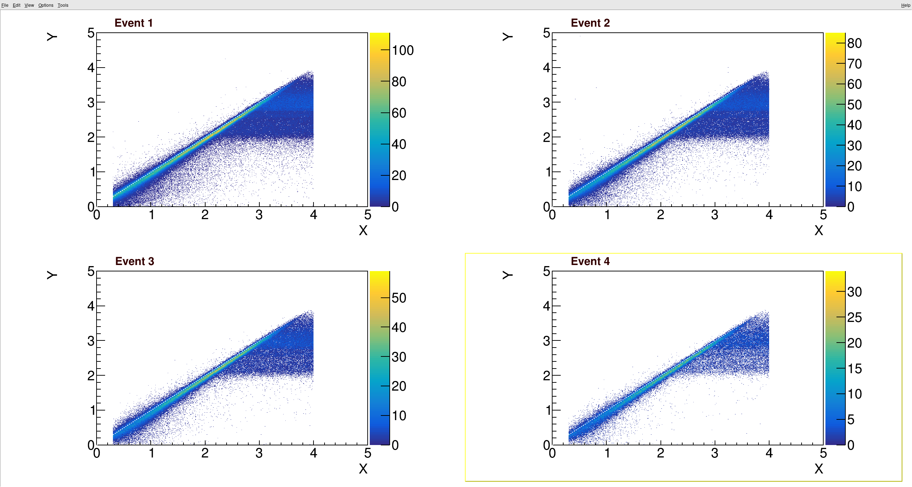
Problem 2: Dieviation of Diagonal
Energy regression
4 / 7
Notes:
This checks whether the gain is only an average effect. The energy-binned plot shows CrossAttention remaining competitive across bins, with the advantage most visible in the low-energy region. The physics caveat is that high-energy tracks are harder because clipping becomes more frequent.

Slide 5
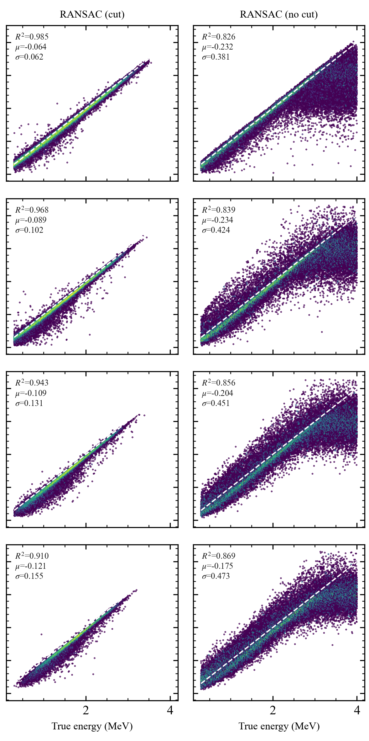
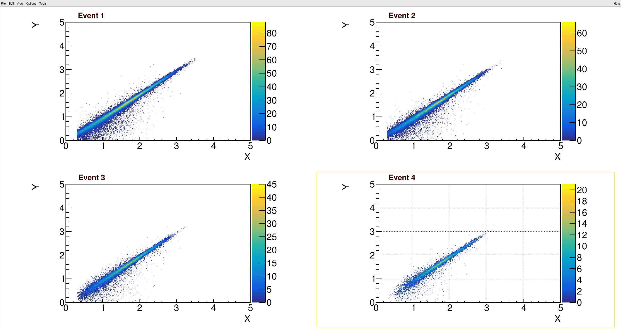
Problem 2: Dieviation of Diagonal
Energy regression
5 / 7
Notes:
This checks whether the gain is only an average effect. The energy-binned plot shows CrossAttention remaining competitive across bins, with the advantage most visible in the low-energy region. The physics caveat is that high-energy tracks are harder because clipping becomes more frequent.

Slide 6
Introduction of Conventional Approach Pipeline
1. Raw Hits — MATEROOT platform
Converter Ablation Study
A. LiLu Converter
Alternative point-cloud-to-image method
2. Converter — 80×48×2 image (MATE resolution)
3. Fit — track fitting
B. 1 mm High-Resolution
Finer voxelization than 80×48×2
4. Reconstructed Range — from fit
5. LISE Projection — range→energy (ext.)
C. No Converter
Raw point cloud, fit directly
6. Predicted KE — final output
Energy regression
6 / 7
Notes:
This checks whether the gain is only an average effect. The energy-binned plot shows CrossAttention remaining competitive across bins, with the advantage most visible in the low-energy region. The physics caveat is that high-energy tracks are harder because clipping becomes more frequent.

Slide 7
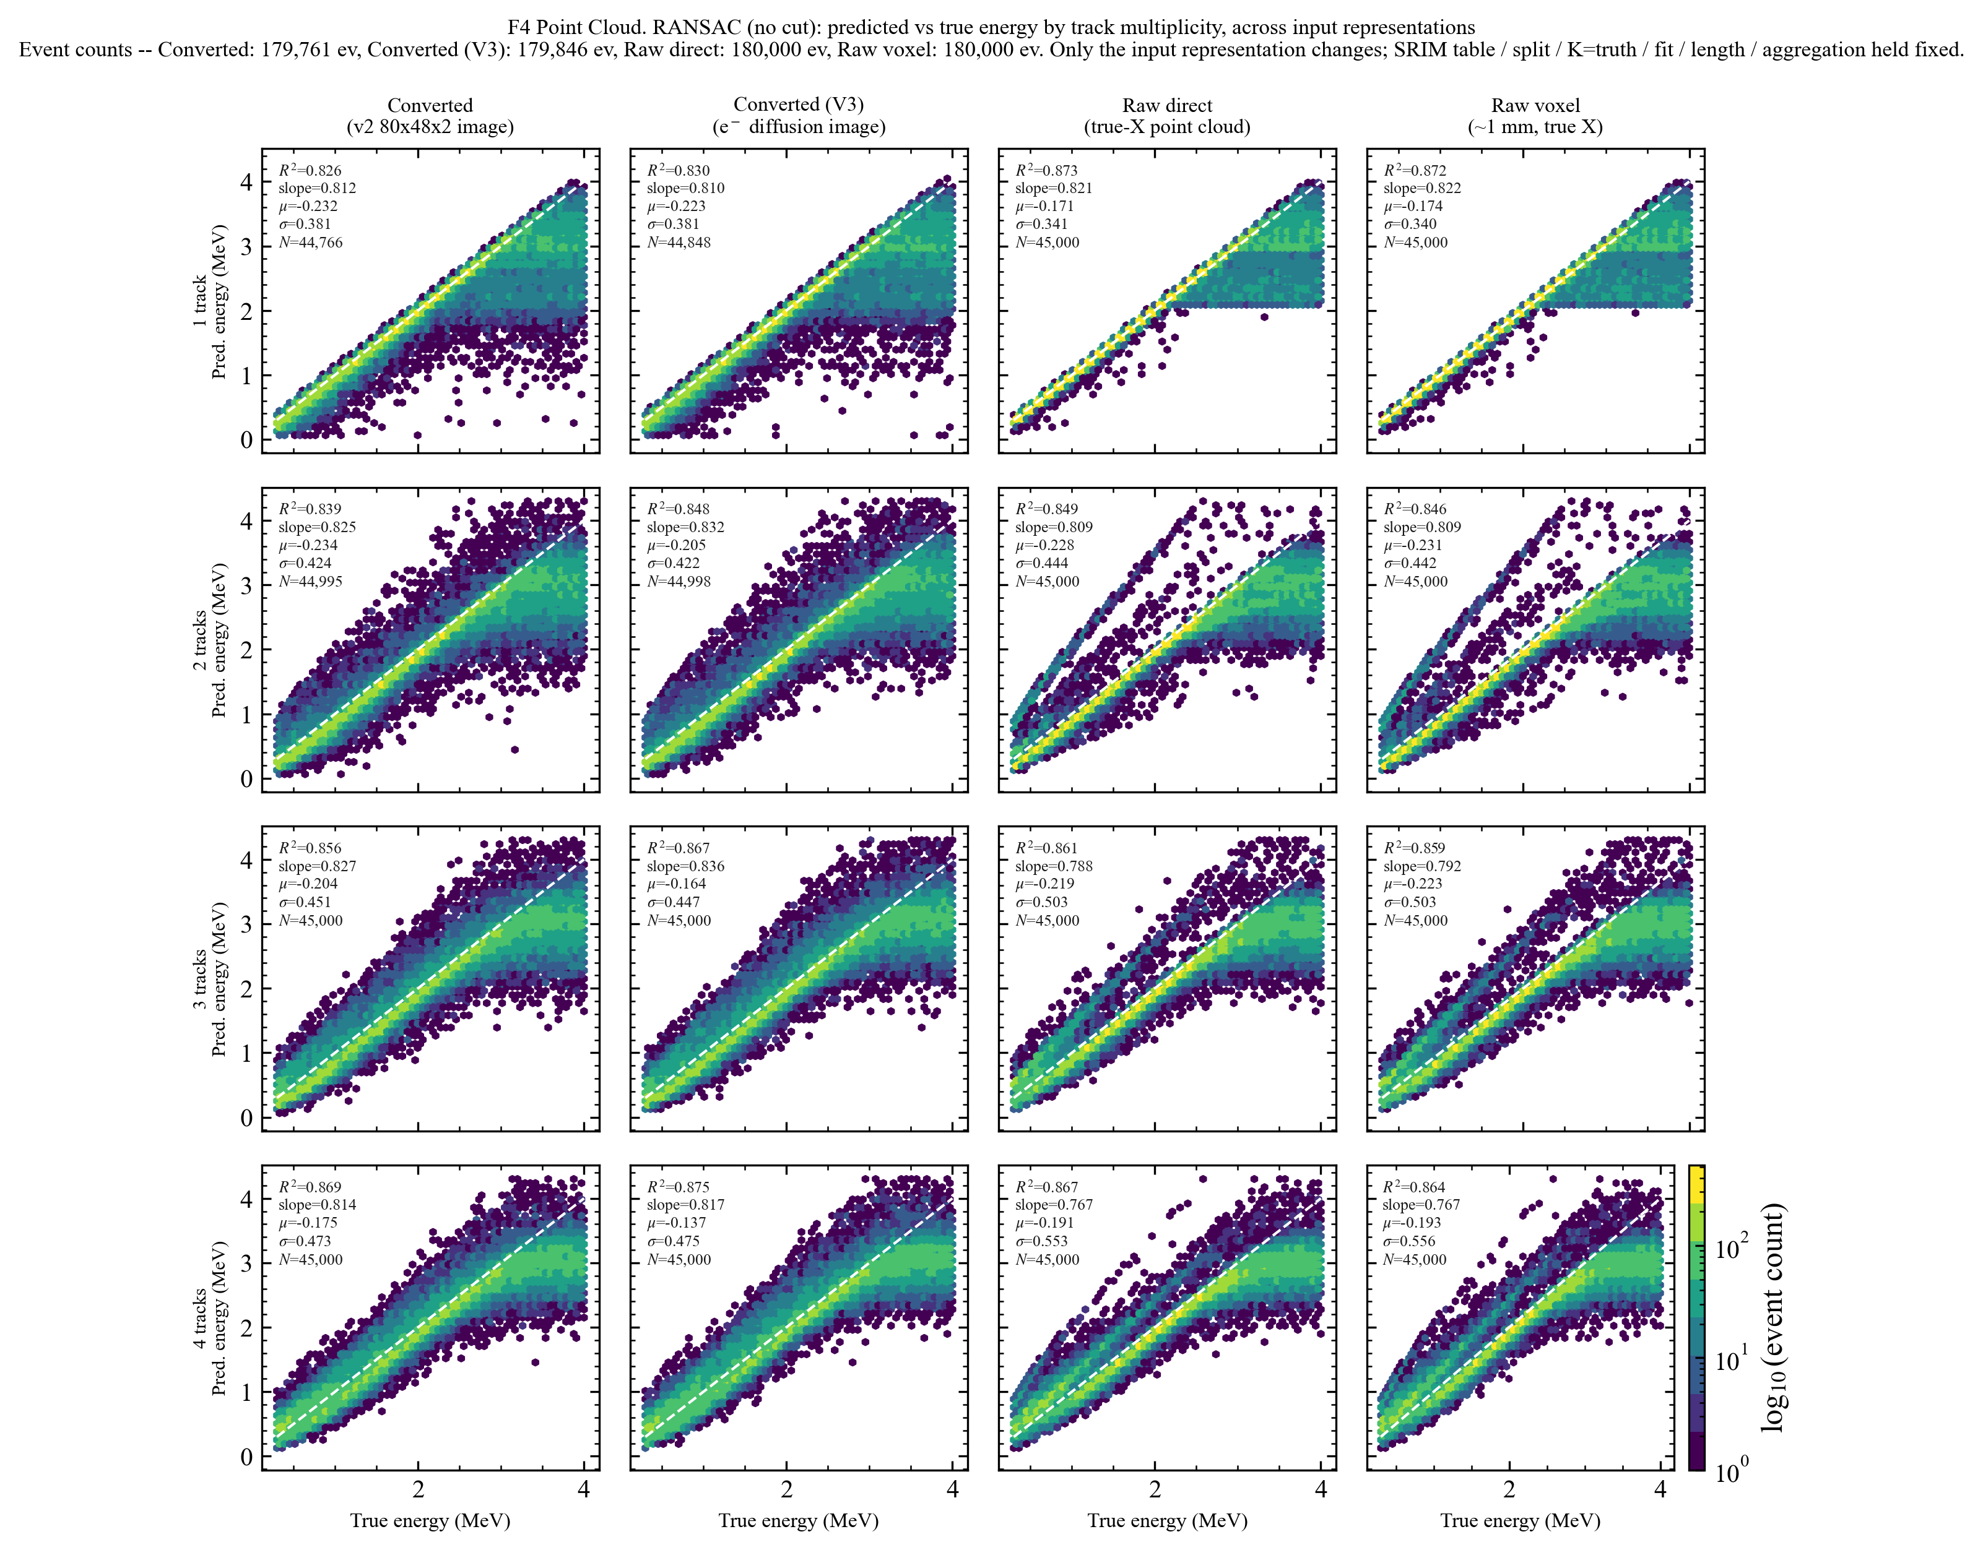
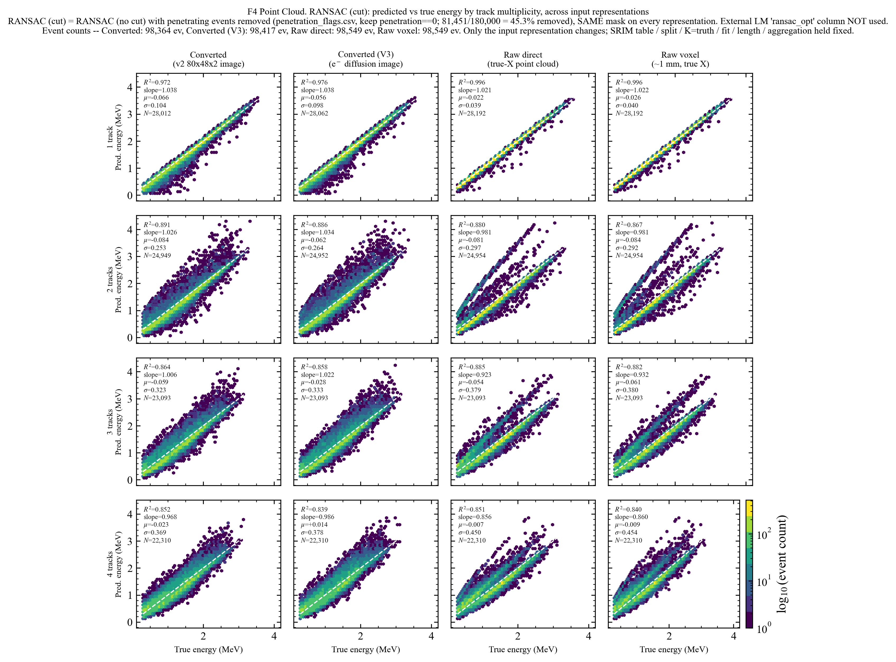
Comparison of Different Converter
Energy regression
7 / 7
Notes:
This checks whether the gain is only an average effect. The energy-binned plot shows CrossAttention remaining competitive across bins, with the advantage most visible in the low-energy region. The physics caveat is that high-energy tracks are harder because clipping becomes more frequent.

